Slide 1
INTRODUCTION TO COMPUTING
Course Code: CCINCOM/L
Heaps
Joseph Marvin R. Imperial
Faculty
Department of Computer Science
College of Computing and Information Technologies (CCIT)
National University
Joseph Marvin R. Imperial
DATA STRUCTURES AND ALGORITHMS
NU College of Computing and Information Technologies
Course Code: CCDATRCL

Slide 2
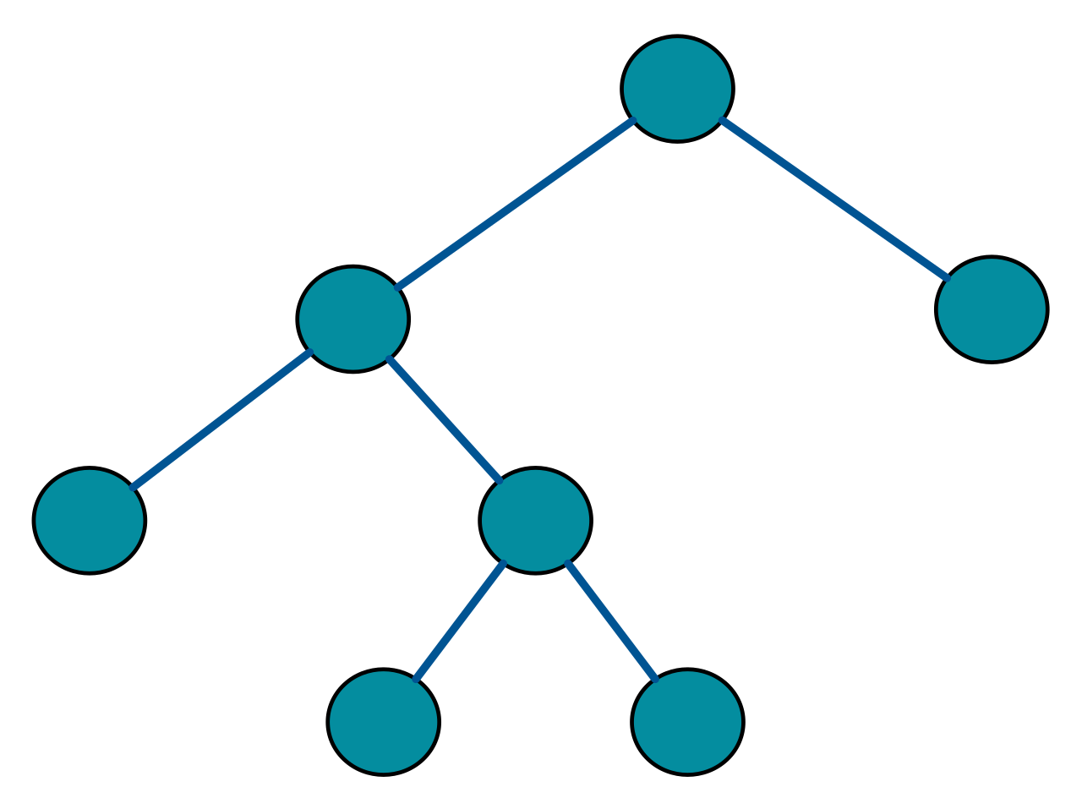
Types of binary trees
Full binary tree - a tree in which every node has either 0 or 2 children.
Joseph Marvin R. Imperial
DATA STRUCTURES AND ALGORITHMS
NU College of Computing and Information Technologies
Course Code: CCDATRCL

Slide 3
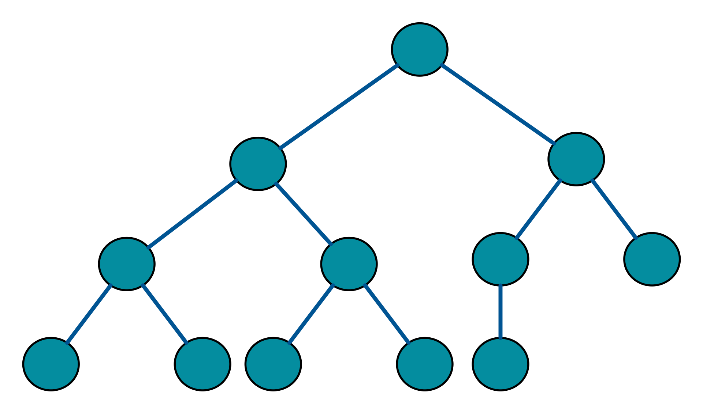
Types of binary trees
2. Complete binary tree – a tree is a binary tree in which every level, except possibly the last, is completely filled, and all nodes are as far left as possible.
Joseph Marvin R. Imperial
DATA STRUCTURES AND ALGORITHMS
NU College of Computing and Information Technologies
Course Code: CCDATRCL

Slide 4
The Heap
A heap is a data structure based on a binary tree with additional properties. The two properties of a heap all boils down to the shape of the tree, and the order of the tree’s nodes.
For a binary tree to qualify as a heap, its shape or structure must be complete binary tree
The order of the nodes depends on two properties:
min-heap property
max-heap property
Joseph Marvin R. Imperial
DATA STRUCTURES AND ALGORITHMS
NU College of Computing and Information Technologies
Course Code: CCDATRCL

Slide 5

In simpler words
A heap is really nothing more than a binary tree with some additional rules that it has to follow.
In a heap, the highest (or lowest) priority element is always stored at the root.
Joseph Marvin R. Imperial
DATA STRUCTURES AND ALGORITHMS
NU College of Computing and Information Technologies
Course Code: CCDATRCL

Slide 6
The Heap Properties
A binary heap is a complete binary tree which satisfies the heap ordering property. The ordering can be one of two types:
min heap property - the value of each node is greater than or equal to the value of its parent, with the minimum-value element at the root (key(α) ≤ key(β)).
max heap property - the value of each node is less than or equal to the value of its parent, with the maximum-value element at the root (key(α) ≥ key(β)).
Joseph Marvin R. Imperial
DATA STRUCTURES AND ALGORITHMS
NU College of Computing and Information Technologies
Course Code: CCDATRCL

Slide 7
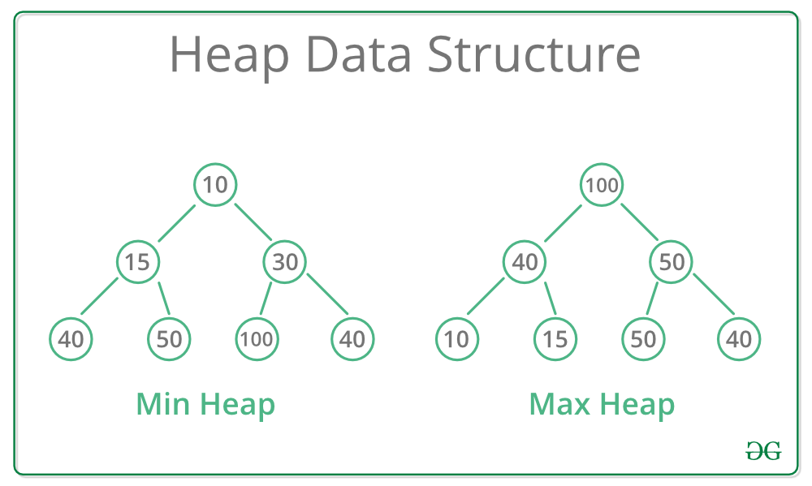
Joseph Marvin R. Imperial
DATA STRUCTURES AND ALGORITHMS
NU College of Computing and Information Technologies
Course Code: CCDATRCL

Slide 8
Constructing a heap
The algorithm below is for creating a max heap by inserting one element at a time. At any point of time, heap must maintain its property. While insertion, we also assume that we are inserting a node in an already heapified tree.
Create a new node at the end of heap.
Assign new value to the node.
Compare the value of this child node with its parent.
If value of parent is less (greater) than child, then swap them.
Repeat step 3 & 4 until Heap property holds.
Joseph Marvin R. Imperial
DATA STRUCTURES AND ALGORITHMS
NU College of Computing and Information Technologies
Course Code: CCDATRCL

Slide 9
Constructing a heap
Joseph Marvin R. Imperial
DATA STRUCTURES AND ALGORITHMS
NU College of Computing and Information Technologies
Course Code: CCDATRCL

Slide 10
Try constructing a heap
Min and max heap:
1. 4, 1, 6, 10, 11, 13, 5, 2
2. 36, 21, 23, 29, 31, 34, 24, 15, 49
Joseph Marvin R. Imperial
DATA STRUCTURES AND ALGORITHMS
NU College of Computing and Information Technologies
Course Code: CCDATRCL

Slide 11
References
Heaps – Carnegie Mellon University: https://www.cs.cmu.edu/~adamchik/15-121/lectures/Binary%20Heaps/heaps.html
Loving Heaps: https://medium.com/basecs/learning-to-love-heaps-cef2b273a238
Joseph Marvin R. Imperial
DATA STRUCTURES AND ALGORITHMS
NU College of Computing and Information Technologies
Course Code: CCDATRCL

